Slide 1
JFK CONSULTANT, LLC
This Photo by Unknown Author is licensed under CC BY

Slide 2
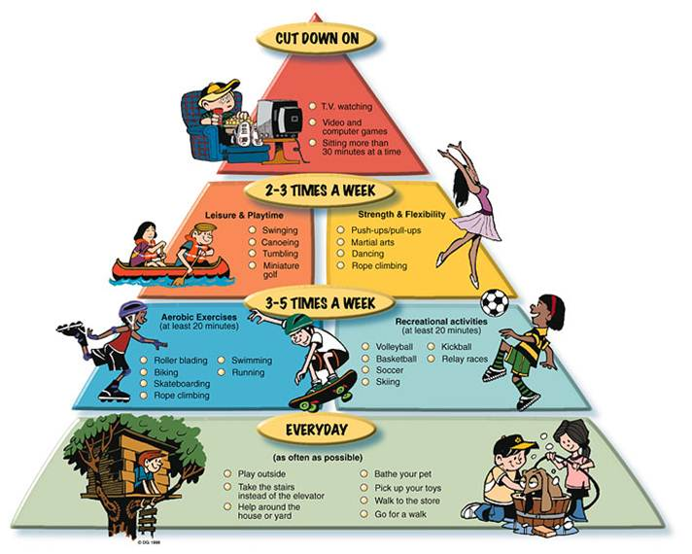
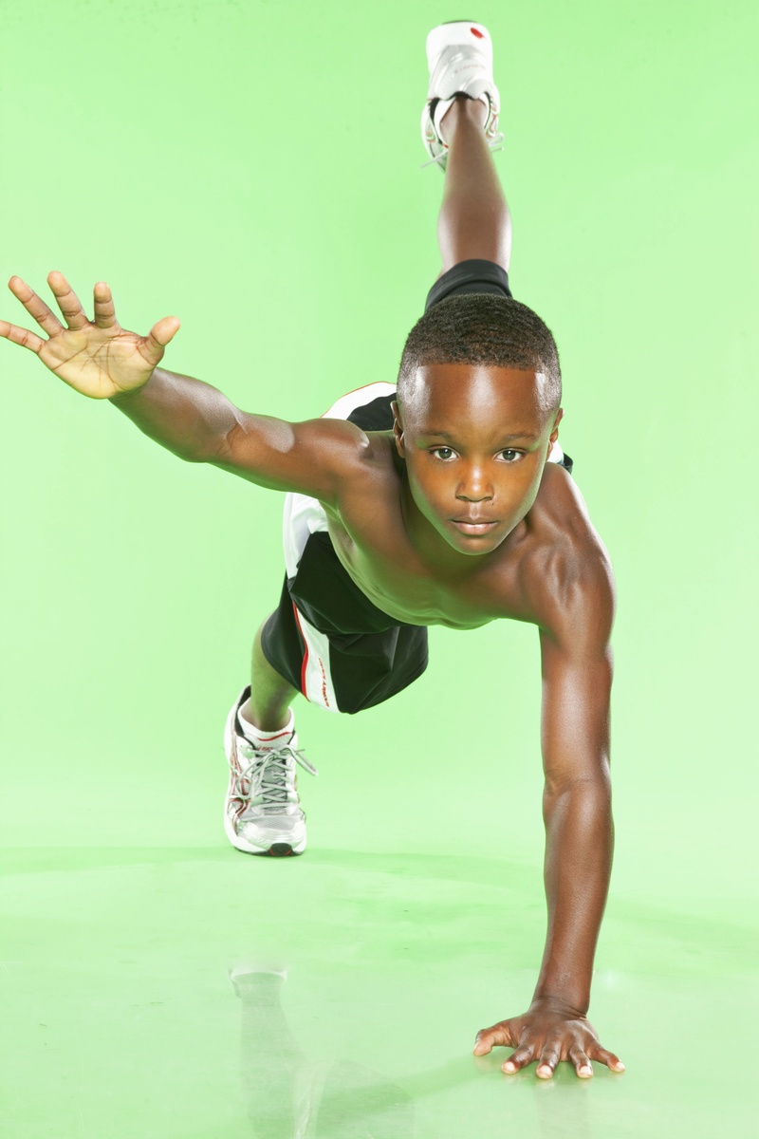
Let’s Get Physical
Did you have fun making up new exercises last week?
What exercises did you do?
How many happy faces do you have on your calendar from last week?

Slide 3
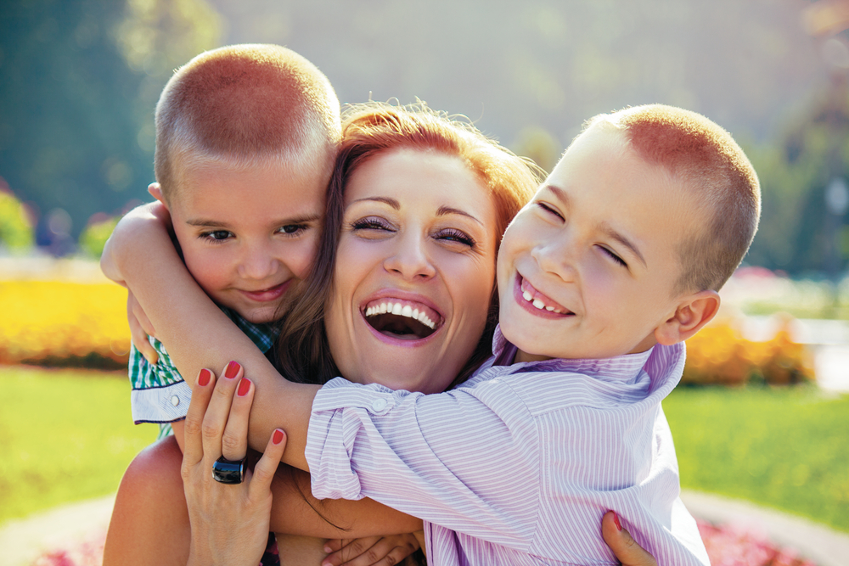
She cooks for me.
Tell me why you love your Mother/Mom?
She gives me kisses.
She gives me hugs.

Slide 4
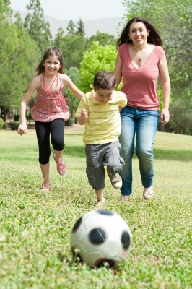
Ask the child to tell you some of the fun things they do with their mom.
Ask the child what is their favorite thing to do with their mom.

Slide 5
Book of the week
https://www.youtube.com/watch?v=JUZ8gCNYPfA

Slide 6
Advance Words
Let’s grow our vocabulary!

Slide 7
Lost
Unable to find one’s way; not knowing one’s whereabouts.

Slide 8
Backpack
A bag with shoulder straps that allow it to be carried on one’s back.

Slide 9
Walking Trail
A trail is usually a path, track or unpaved lane or road.

Slide 10
Worry
Give way to anxiety or unease; allow one's mind to dwell on difficulty or troubles,

Slide 11
Camp Fire
An open-air fire in a camp, used for cooking, and as a focal point for social activity.

Slide 12
Cozy
Giving a feeling of comfort, warmth, and relaxation.

Slide 13
Tuckered Out
To cause someone to become very tired.

Slide 14
Book Reflection
Have you ever been lost?
How can you help your mommy?
How many blueberries do you think will full a cup up?
Have you ever used a diagram/instructions to build something?
Have you ever been tuckered out?

Slide 15
Family Activities

Slide 16
Writing Corner
This week have your child draw lines from left to right.
Wow!!! Let’s see the different things your child can write. The following examples below can be written when we put the two lines together.
Square Rectangle
Letters: T, t, I, L, and H.
Number: 1

Slide 17
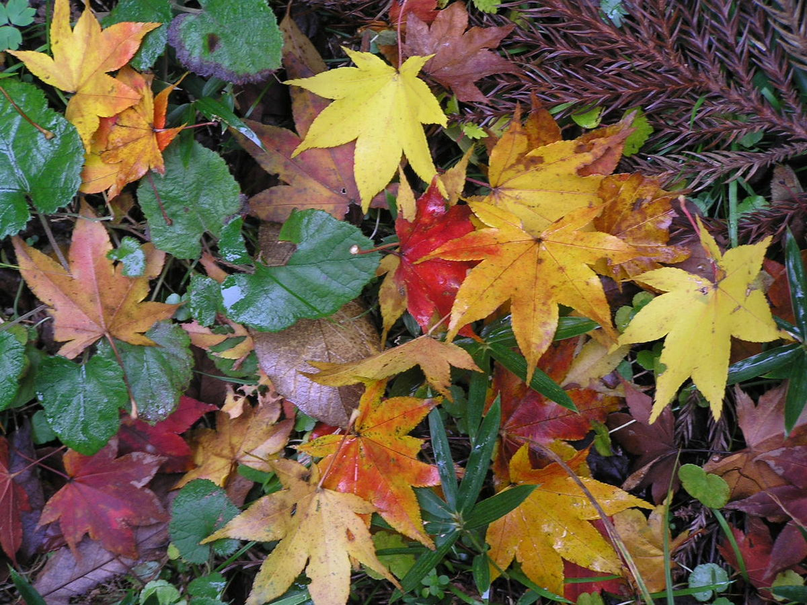
Alphabet Knowledge
This week we will focus on the letter, “L”. As you discuss it throughout the week, have a scavenger hunt. Let’s see how many L’s you can find.
Leaves

Slide 18
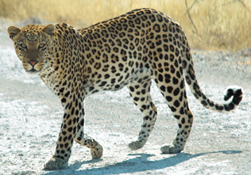
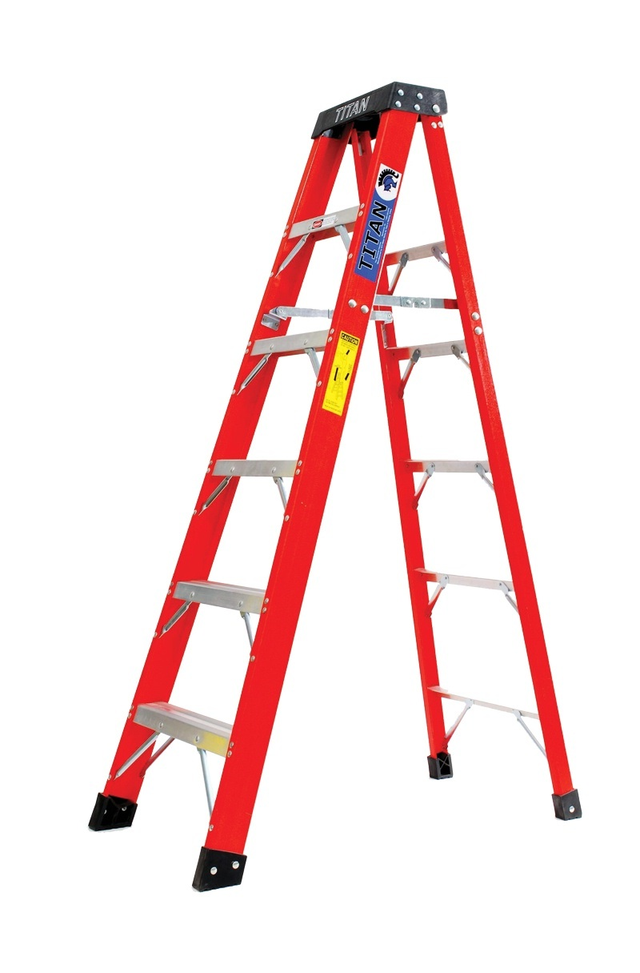
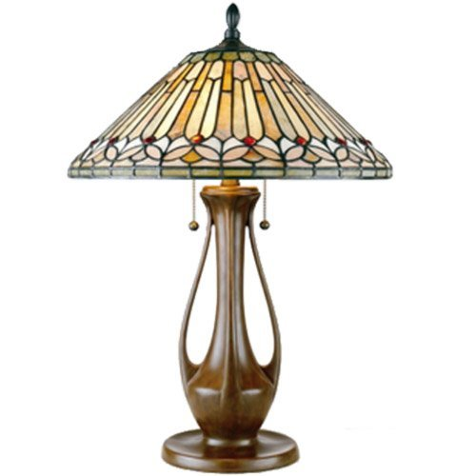
Sample “L” Words
Lettuce
Leopard
Lock
Lamp
Ladder
Light

Slide 19
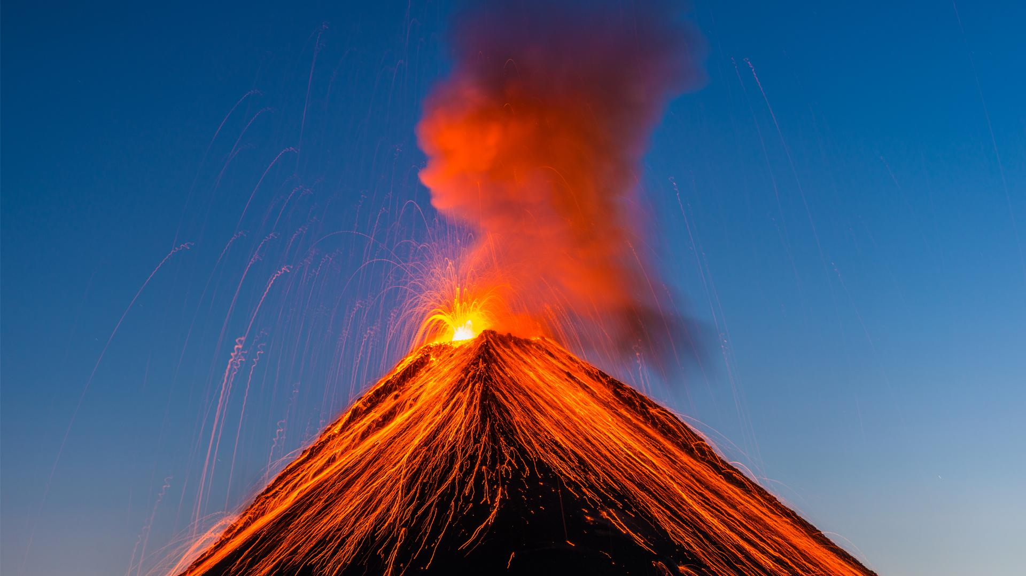
Lava Volcano
Here a fun activity you can do with the child/children, all you need is:
Baking Soda
Vinegar (any kind)
Red Kool-Aid
Bowl
Allow the child to experiment with different amounts of baking soda, vinegar, and kool-aid. Ask the child to predict what will happen. Assist the child with this experiment. Allow the child to draw what what he/she observes; this is called data.

Slide 20
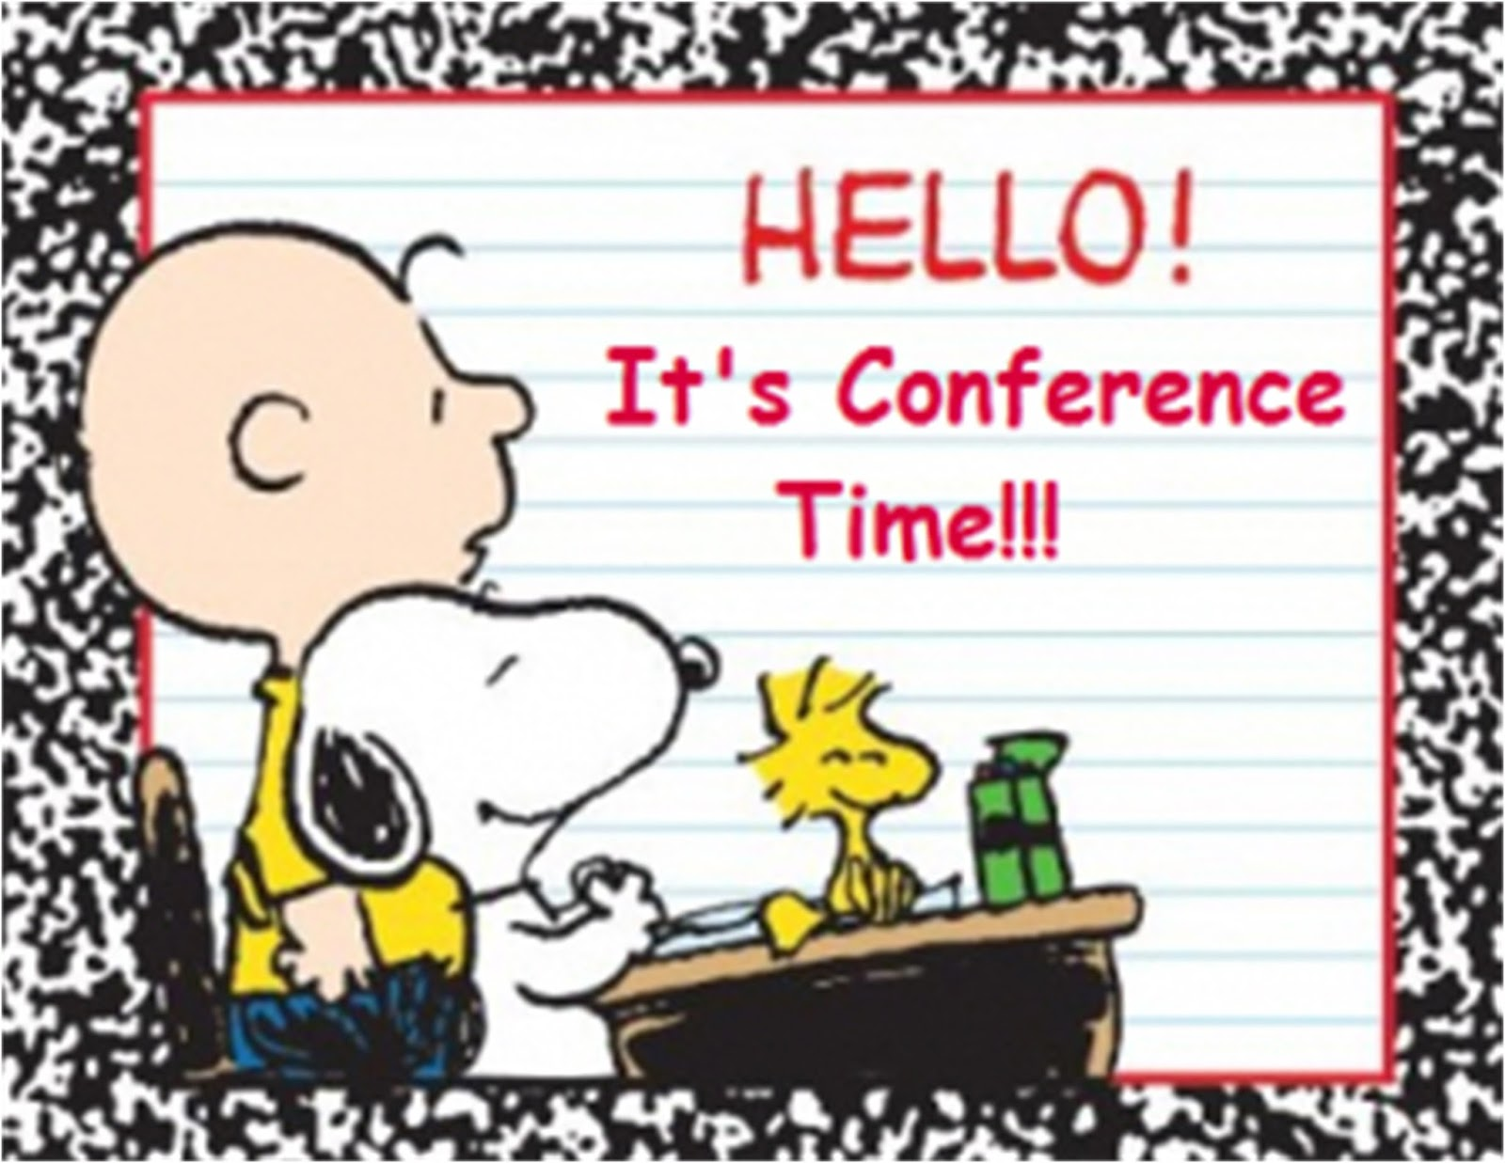
Table Talk
How are you doing mom/dad?
Will you be returning to work soon?
What is your stress level on a scale from 0-10?
Have a Happy Mother’s Day!

Slide 21
Additional Resources
https://www.education.com/worksheet/article/circle-the-number/
Math: Counting
https://www.youtube.com/watch?v=68YeoDe8rAg
Mommy do you love me?

Slide 22
References
https://www.education.com/worksheet/article/circle-the-number/
Math: Counting
https://www.youtube.com/watch?v=68YeoDe8rAg
Mommy Do You Love Me?
https://www.youtube.com/watch?v=JUZ8gCNYPfA
Because your mommy loves you

